Slide 1
Idealism
Mrs Nadia Ali
Assistant Prof
Dept of International Relations

Slide 2
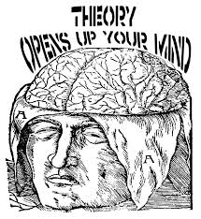
What is a Theory?
Theory is a linked set of propositions or ideas that simplify the complex reality , the events that have happened, explain why they happened and predict what might happen in future.

Slide 3
What is Idealism?
Oxford Dictionary define Idealism as representation of things in an ideal form, imaginative treatment, system of thought in which the object of external perception is hold to consist of ideas.
Idealism is a theory of IR which believes in the peace and harmony among the nation states.
Idealism believes that man is not evil. It is the system which generates conflicts between them and removes peace.
Idealism is a specific school that stresses the need for states to pursue moral goals and to act ethically in the international arena.
Idealism don’t believe in power politics.
They see the future of Int-system based on the notion if reformed Int-system free from power politics

Slide 4
Historical Background
Idealism can be found in description of Peloponnesian War (Athenians to practice “What is fair and right and in the sprit of cooperation)
As early as the 14th Century the Italian poet Dante wrote of the “universality of man” and envisioned a unified world state
Immanuel Kant argued that “a world of good, morally responsible states would be lesser likely to engage in wars”
Congress of Vienna 1815 also provided a long term peace in Europe after French Revolution and Napoleon Wars
This school came in prominence after at the end of WWI(1914-1918)

Slide 5
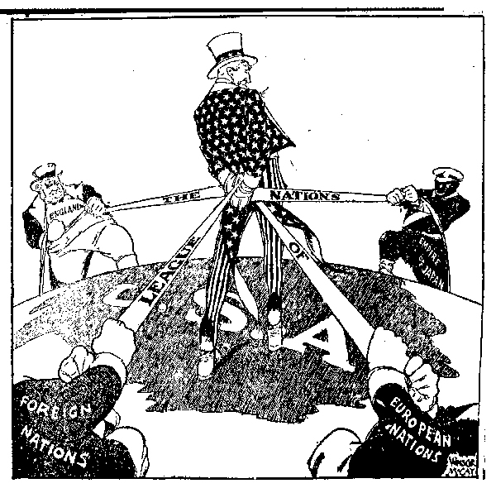
Historical Background….
President Woodrow Wilson gave the Idea of League of Nations also refer as Wilsononian Idealism.
Failure of LON and Idealism.
World WAR II (1939-1945) broke out.
A shock to world. Realpolik in power
Creation of United Nations 1945

Slide 6
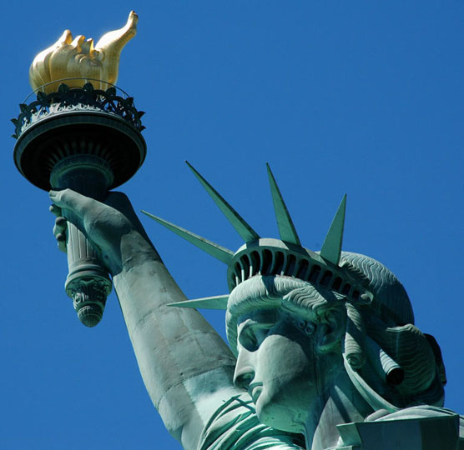
Focus of Idealism
Freedom
Cooperation
Peace
Progress

Slide 7
Focus of Idealism…
Freedom can only be achieved if Human rights are given to every one living in world society.
Int-Cooperation and engagement are possible if all states adhere to basic global norms, war can be avoided and peace will result
Focus attention on legal-formal aspects of international relations, such as international law and international organizations
If there will be freedom, Cooperation and peace it will lead towards progress-progressive world.

Slide 8
Features of Idealism
Universal Ethics -- All humans should abide by common standards such as natural laws. There is a universal ethic common to all people
Peace is better than war -- War is seen as immoral by idealists, by others is only as a last resort and for a just cause.

Slide 9
Harmony of interests -- Idealists believe it is possible for humans to live together in harmony if the proper measures are taken.
People are good: Idealists are more optimistic about human nature. In the proper setting, man would enjoy peace and be free from conflict.

Slide 10
Exponents of Idealism
Brede er de Montesquieu
(Human Nature is not defective, problems arise as humanity enter civil society and forms separate nations)
Immanuel Kant
(Int- anarchy can over come through some kind of collective actions)
Woodrow Wilson
(war is preventable, idea of collective security system i-e League of Nations)

Slide 11
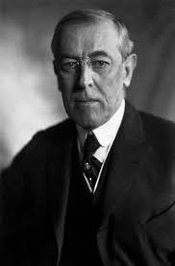
Case Study: Woodrow Wilson Fourteen Points

Slide 12
Case Study: Woodrow Wilson Fourteen Points
In 1919 Paris peace conference took place
The victorious powers met in Paris in 1919 to determine the postwar settlement after WWI
Representatives from the Central Powers were not invited to attend
The Russians were not invited to attend
The French, British, and Americans dominated the conference

Slide 13
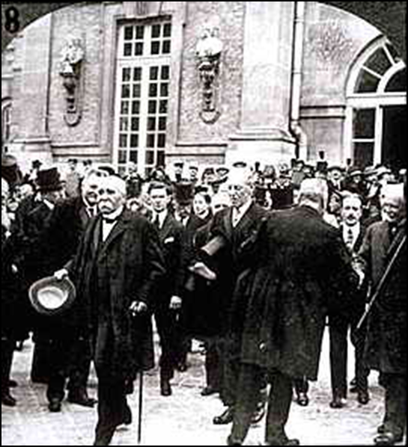
Georges Clemenceau (France), Lloyd George (Britain), and Woodrow Wilson (US) at Versailles

Slide 14
Wilson's 14 points
Wilson envisioned:
Open covenants of peace, openly arrived at,
Absolute freedom of navigation upon the seas in peace and in war,
The removal of all economic barriers and the establishment of an equality of trade conditions among all nations,
Adequate guarantees for a reduction in national armaments,
Adjustments of colonial disputes to give equal weight to the interests of the controlling government and the colonial population, and
A call for “a general association of nations”

Slide 15
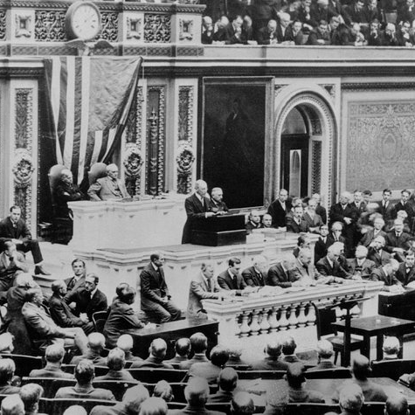
Wilson Address during Paris Peace Conference

Slide 16
Idealism in Post World War II
Another effort of idealist was the creation of United Nations at the end of World War II. Ideals can be found embed in the charter of UN
Since then many other regional organization also formed to created peace and harmony among the states . EU,NATO,ASEAN, NAFTA etc
The creation of Bretton Wood system also aimed at providing economic stability in world.
Idealism has now transformed into Liberalist which believe in stable International System based on economic interdependence, regional integration and cooperation in areas which war appeared unlikely

Slide 17
Theories generated from Idealism
Liberalism
Neo Liberalism
Neo Liberal Institutionalism
Integration
Globalization

Slide 18
Critics of Idealism
The Realist believe Idealism as fail theory.
It is far from reality.
Practically failed.
Critics argue that the war came as a result of idealists’ native legalistic and moralistic assumptions about the possibility of peace and progress through human aspiration.
The element of power cant be ignored.
Is realism is disguise in idealism i-e The role of Super Power, North South Gap, Globalization???
Freedom, Cooperation, Peace and Progress?

Slide 19
Thank you

